Slide 1

Vinyl Hung Window WOCD – Installation/Operation Instructions
⚠ WARNING
Possible Fall Hazard
Young children may fall out of the window if the opening control device is not installed correctly.
Install the device so that a rigid 4.0-in. diameter sphere does not pass through any space in the window opening after the window opening control devices are in place.
Young children may fall out the window if all installation instructions are not followed.
Use recommended materials and techniques.
Make sure that the window opening control device is securely installed in accordance with manufacturer’s instructions.
Make sure that the window frame is in good condition.
BEFORE INSTALLATION
The following steps may require fabrication involving use of cutting tools. Please work safely. Proper application of these devices is required. Follow the manufacturer’s installation instructions carefully. Failure to do so may result in the window opening control device’s being ineffective in controlling the window opening which can cause accidental window falls. Contact local building code department or fire department for specific applicable codes before installing the devices. Quanex recommends that you also consult with local building codes for egress size requirements. The devices shall be installed such that the release mechanism is in conformance with local building and fire code requirements. The device is single action so two devices are required per window unit. A copy of this instruction shall be left with the owner of the building or occupant of the dwelling where the window opening control device is installed. The window manufacturer’s window label and/or information packet provided with the window shall contain the following statement: “This window contains a WOCD device which complies with ASTM F-2090-08/ 10/ 13/ 17/ 21.” It is recommended that Quanex be contacted to perform an application review prior to installation.
P/N 74050 2/25/26
2026

Slide 2
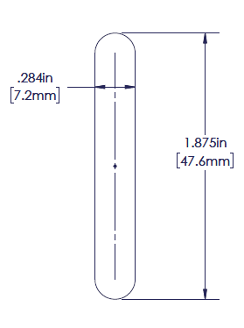
Vinyl Hung Window WOCD – Installation/Operation Instructions
INSTALLATION INSTRUCTIONS
Two WOCD devices are required per window unit.
Route or punch a hole on each side of the window jamb for a single hung or on each top sash stile for a double hung.
The hole dimensions shall be .284” wide by 1.875” long as shown in Figure 1.
Figure 1

Slide 3
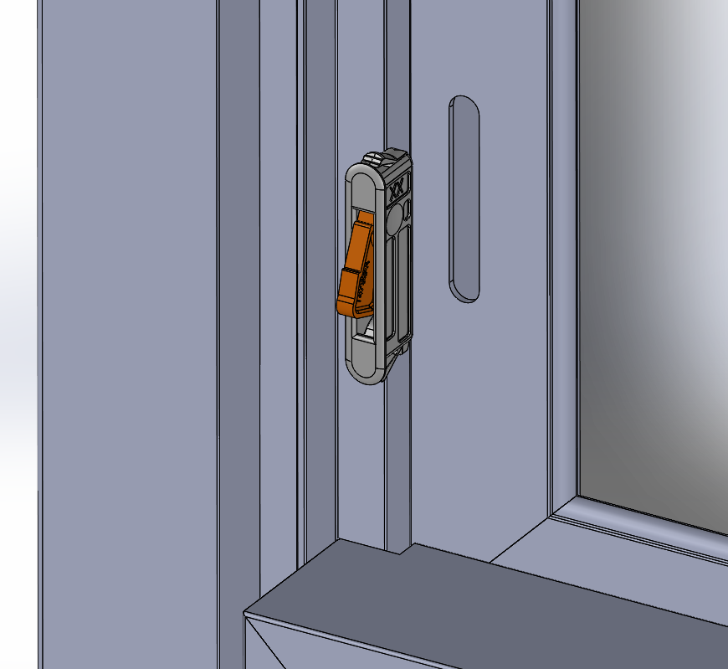
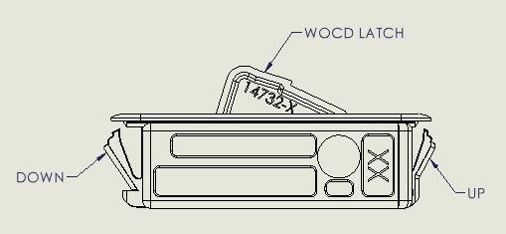
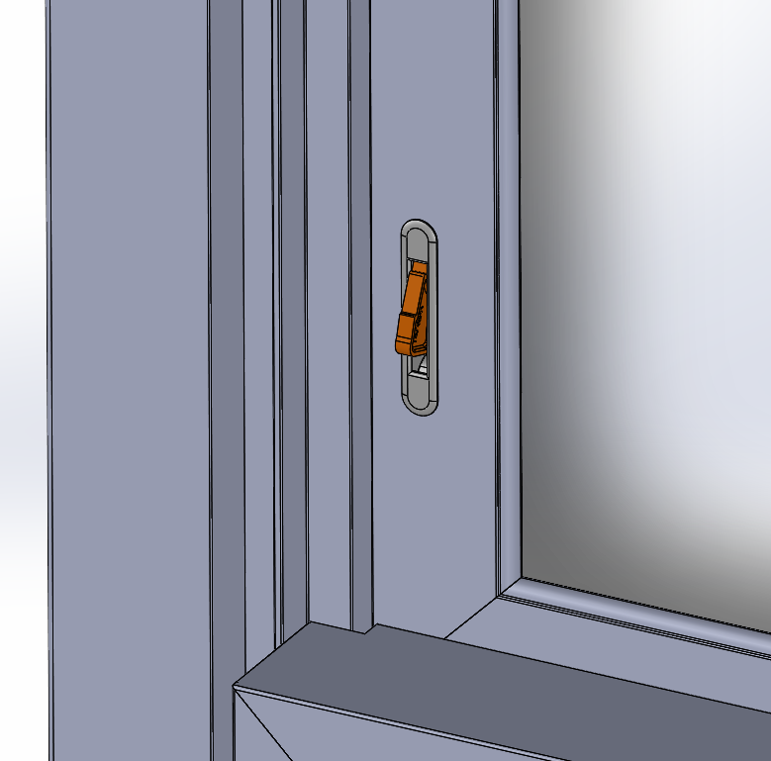
Vinyl Hung Window WOCD – Installation/Operation Instructions
4.The fabricated holes must be positioned such that the lower sash has a clear opening of less than 4” after being stopped by the WOCD devices.
5. Care must be taken to orient the devices as shown in Figures 2 and 3 before insertion into the fabrication. DOWN is in the direction of the window sill and UP is in the direction of the window head.
Figure 2
Figure 3
6. After confirming the device orientation, firmly press each device into the fabricated holes until they are fully engaged as shown in Figure 4. The snap legs are designed to accommodate a variety of vinyl wall thicknesses.
Figure 4

Slide 4
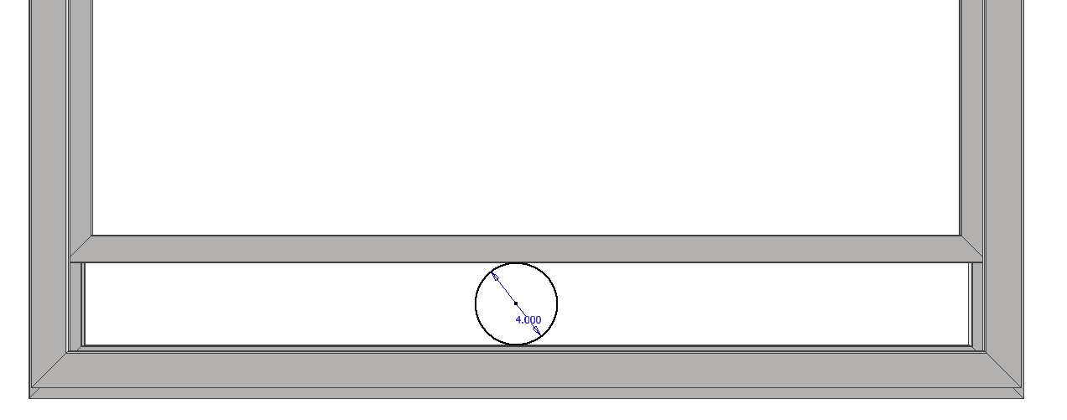
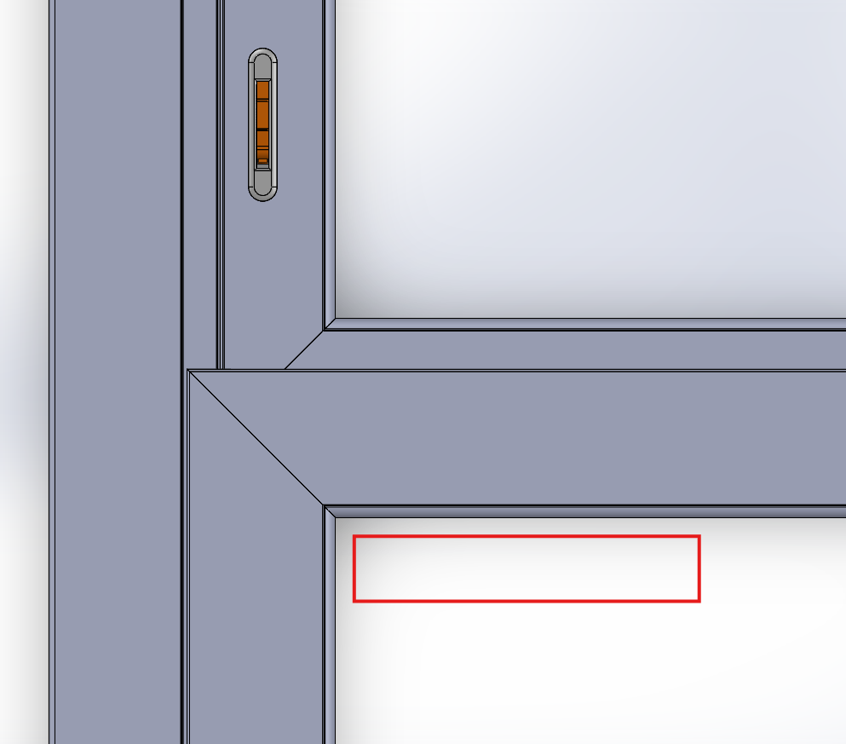
Vinyl Hung Window WOCD – Installation/Operation Instructions
7. Open the sash until it is stopped by the window opening control devices. Check that the clear opening is less than 4 inches by verifying that a 4-inch diameter rigid sphere cannot pass through the lowest opening in the window as depicted in Figure 5.
Figure 5
8. Recommended: Add decal containing WOCD operating instructions near the device as shown in Figure 6.
Figure 6

Slide 5
Vinyl Hung Window WOCD – Installation/Operation Instructions
IMPORTANT SAFETY INFORMATION
INSTALLER PLEASE LEAVE BEHIND FOR THE OCCUPANT
A copy of the safety information shall be provided to the owner of the building in which the window opening control device (WOCD) is installed and to the occupant in the dwelling where the WOCD is installed (or is to be installed). A window decal sticker shall be adhered to the corner of the glass next to the installed WOCD (visible and readable from interior).
⚠ WARNING
No Window Rescue Above 75 ft (6th Floor)
⚠ WARNING
Blocks Escape in Fire and Emergency Unless Released
Fire rescue ladder may not reach beyond 75 ft (6th Floor).
Do not rely on being rescued from windows above 75 ft (6th Floor). Follow building fire escape plan.
Need to properly operate release mechanism to open window opening control device by: Opening the sash until it contacts the devices then push in each protruding latch until they drop behind the sash.
Never apply padlocks or devices that require a key or tool to unlock them to the release mechanism of the window opening control device(s).

Slide 6
Vinyl Hung Window WOCD – Installation/Operation Instructions
⚠ WARNING
Possible Fall Hazard
This window opening control device is designed to protect against accidental operation of windows by children five years and younger.
This window opening control device is not a substitute for attentive supervision of all young children.
Keep window opening control device(s) properly engaged unless needed for use in an emergency.
WOCD shall be installed in such a manner that, after the device is installed and engaged, no space shall exist at the lowest opening portion of the window opening that would permit the passage of a rigid sphere measuring 4-in. (102mm) in diameter. Failure to follow these instructions may result in the device being ineffective in controlling the window opening.
After each release of WOCD, device should be checked for re-engagement and operability before being securely locked. Please see operating instructions
Please review operating instructions for proper releasing and re-engaging procedure. Occupant(s) are responsible for understanding the proper operation. The release mechanism should be operated during emergency egress/ingress situations or when the device is being checked as part of proper maintenance.
It is required that all household and occupants six (6) years old and older should be trained to know how to operate the release mechanism in case of an emergency.
WOCD shall be maintained and tested on a monthly basis (once per month) and after testing the window must be closed securely.
With consideration of factors outside the influence of the WOCD, Quanex recommends operable windows be closed and locked when forecasted winds exceed 25 MPH. Keeping the windows closed during adverse weather conditions reduces the potential for damage to the windows and hardware.

Slide 7
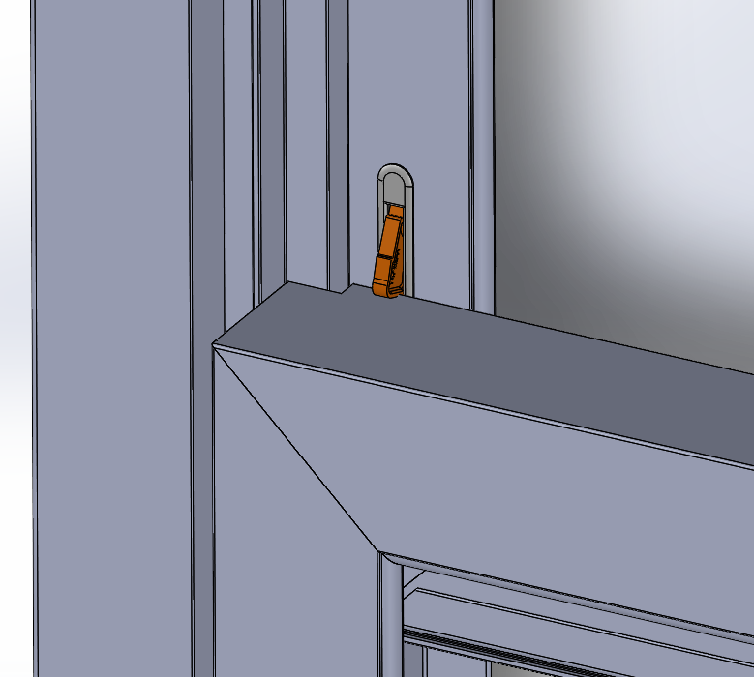
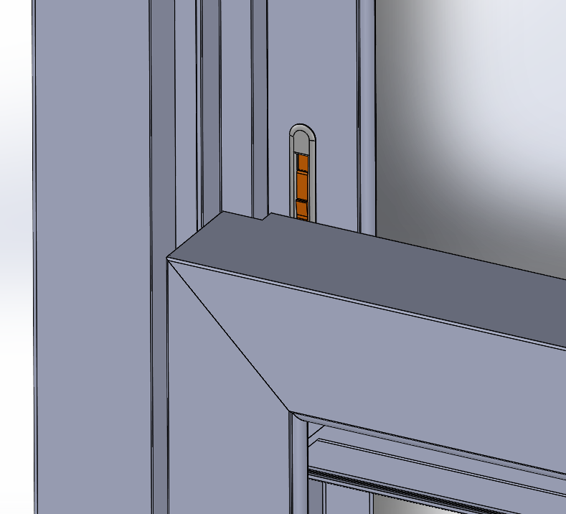
Vinyl Hung Window WOCD – Installation/Operation Instructions
OPERATION INSTRUCTIONS
To Release the WOCD
1. Unlock and open the sash until it is stopped by the window opening control devices
Figure 7
2. Press in both protruding WOCD latches in until they drop behind the sash as shown in Figure 8.
Figure 8
3. Continue opening the sash for cleaning or egress purposes.

Slide 8
Vinyl Hung Window WOCD – Installation/Operation Instructions
To Reset the WOCD
Fully close the sash. Once closed to a point where it no longer contacts the window opening control devices, they will automatically reset, and the latches will be fully extended as shown in Figure 4.
2. Unlock and open the window until limited opening is reached by the sash to verify automatic reattachment has occurred.
3. Close the window and securely lock it.
The information in this document affects your and your children’s safety and your legal rights and responsibilities. Read this entire document carefully to ensure proper configuration and use. Failure to read and follow instructions and warnings in this document may result in serious injury or death to yourself or others. This document and all other collateral documents are subject to change at the sole discretion of AmesburyTruth.
By installing this product as part of your window system, you hereby signify that you have read this disclaimer and warning carefully and that you understand and agree to abide by the conditions and terms herein.
Quanex accepts no liability for damage, injury or any legal responsibility incurred under any use of this product regardless of under any theory of law including tort, contract or strict liability. For warranty information, visit our website at: www.amesburytruth.com.
Window Opening Control Device is tested and complies with ASTM F2090-08/ 10/ 13/ 17/ 21.

